Slide 1
Introduction to Binary Tree
Notes:
Today I am honored to present a short introduction on Binary Tree.

Slide 2
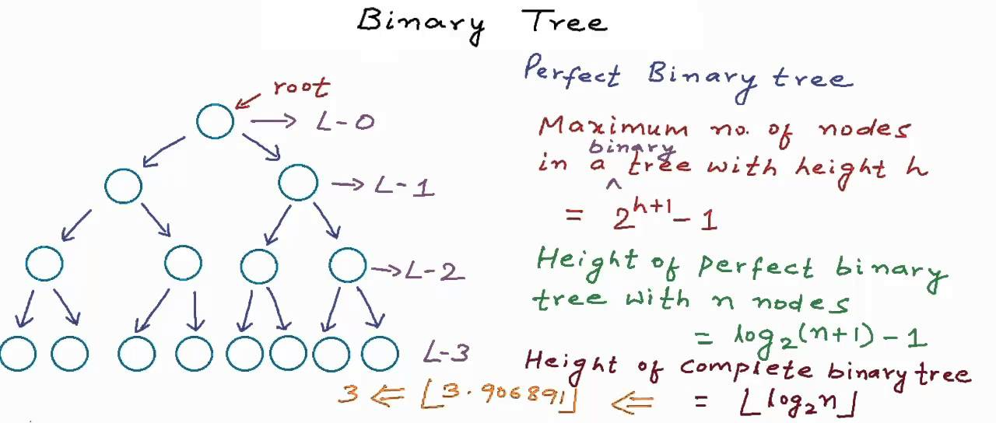
Part I: What is a Binary Tree
o
Notes:
In part I, I would like to explain what is a Binary Tree

Slide 3
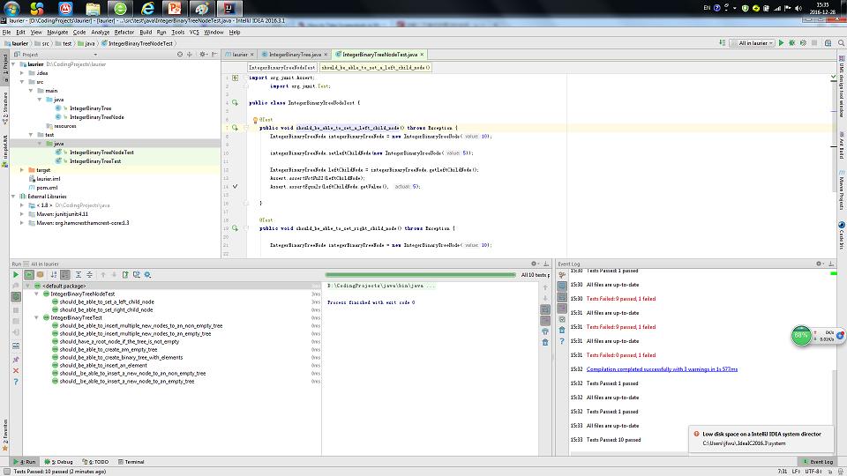
Part II: A Binary Tree Implementation
Notes:
In Part II, I would like to present a simple project which implements a Binary Tree data struction.

Slide 4
Part I: What is a Binary Tree
A Binary Tree is first of all a TREE
Notes:
So what is a Binary Tree? A binary tree is first of all, a Tree

Slide 5

Part I: What is a Binary Tree
A Binary Tree is first of all a TREE
Notes:
We see trees every everywhere. They grow outside.

Slide 6
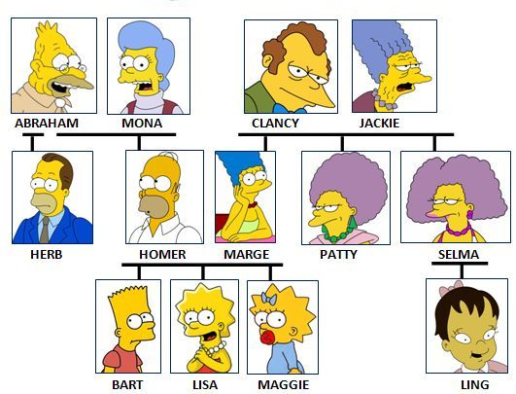
Part I: What is a Binary Tree
A Binary Tree is first of all a TREE
Notes:
We ourselves are parts in our family tree.

Slide 7
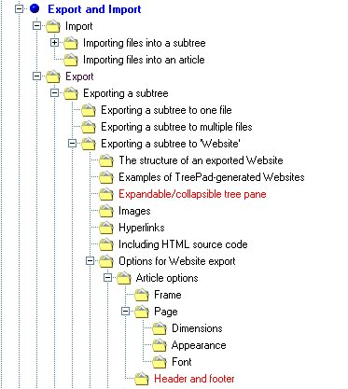
Part I: What is a Binary Tree
A Binary Tree is first of all a TREE
Notes:
In many computer operating system, file system using tree structure to organize files. When you log onto your computer, you probably will see something like this.

Slide 8
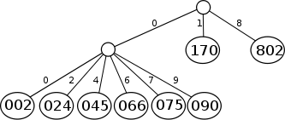
Part I: What is a Binary Tree
A Binary Tree is first of all a TREE
Notes:
So, In computer science, Tree is a data structure that are commonly used to store data. All types of data. Such as numerical data,

Slide 9
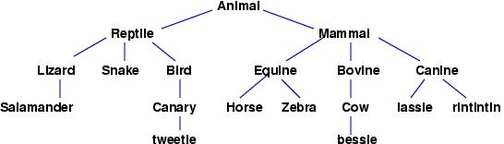
Part I: What is a Binary Tree
A Binary Tree is first of all a TREE
Notes:
,and text data,

Slide 10
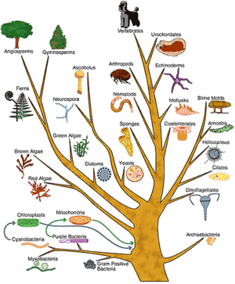
Part I: What is a Binary Tree
A Binary Tree is first of all a TREE
Notes:
, and more complex types of data.

Slide 11
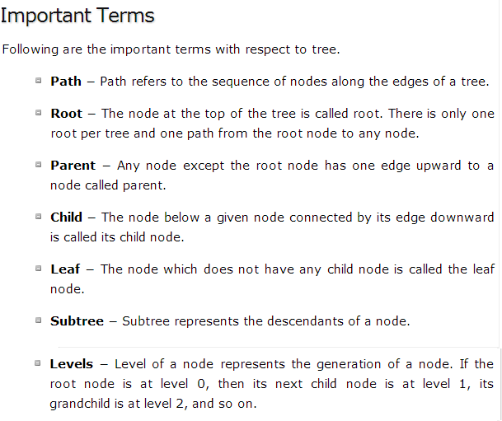
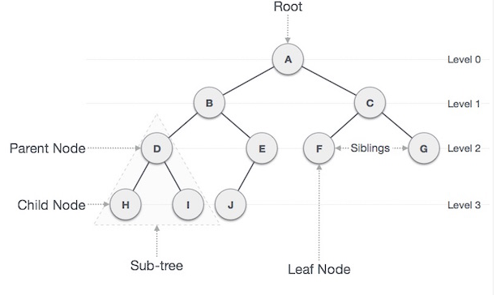
Part I: What is a Binary Tree
A Binary Tree is BINARY
Notes:
As its name suggests, a binary tree is BINARY. Before going into the details of this characteristic, I would like to clarify some important terms associated with tree structures.

Slide 12
Part I: What is a Binary Tree
A Binary Tree is BINARY, meaning:
In a binary tree each node can have a maximum of two children.
Notes:
Now what does Binary means when used to describe a tree structure. A tree is binary when it meets one condition, which is each of the its nodes has at most 2 child nodes.

Slide 13
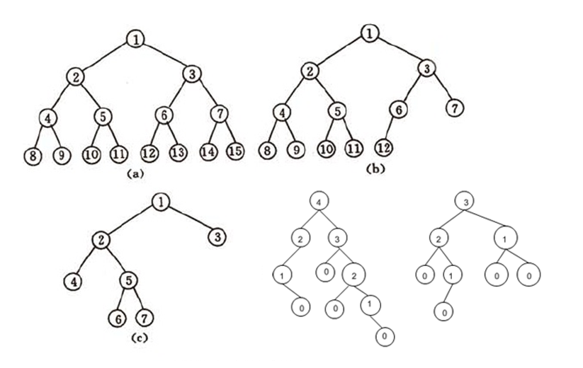
Part I: What is a Binary Tree
A Binary Tree is BINARY, meaning:
In a binary tree each node can have a maximum of two children.
Notes:
These are all binary trees.

Slide 14
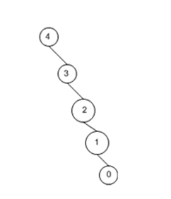
Part I: What is a Binary Tree
A Binary Tree is BINARY, meaning:
In a binary tree each node can have a maximum of two children.
Notes:
Surprisingly, this one is a binary tree too.

Slide 15
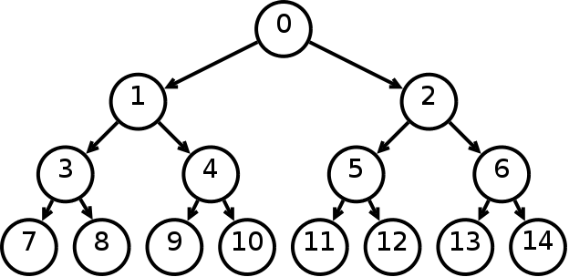
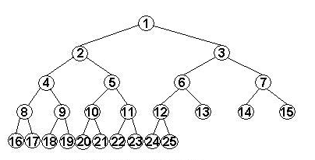
Part I: What is a Binary Tree
There are many variants of binary trees.
Perfect Binary Tree
A binary tree with all leaf nodes on the same level. All internal nodes have 2 child nodes.
Complete Binary Tree
In a complete binary tree every level, except possibly the last, is completely filled, and all nodes in the last level are as far left as possible.
Notes:
Binary Trees could look very different from one another. Actually, there are many variants of binary trees. I would introduce a few most common kinds. A Perfect Binary Tree is a binary tree that every node has 2 ch ild nodes except the leaf nodes, and the leaf nodes are all on the same level. It is not easy to be perfect. But it is also not bad to be close to perfect, like a complete binary tree, which is a binary tree that all non-leaf nodes except some on the last level have 2 child nodes. And the leaf nodes on the last level are as left as possible.

Slide 16
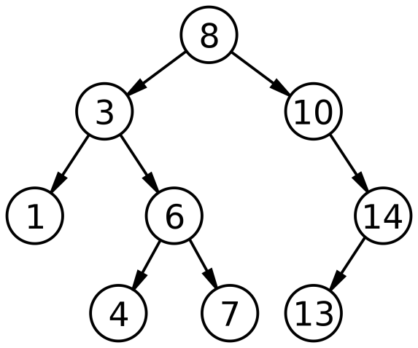
Part I: What is a Binary Tree
There are many variants of binary trees.
Balanced Binary Tree
A balanced tree is a tree where every leaf is “not more than a certain distance” away from the root than any other leaf.
One common balanced tree structure is a binary tree structure in which the left and right sub-trees of every node differ in height by no more than 1
Why Balanced Structure?
Node search, insertion, deletion, … all could take time proportional to the height of the binary tree if its nodes are arranged in certain way.
A balanced tree has a small height.
A unbalanced tree has a bigger height.

Slide 17
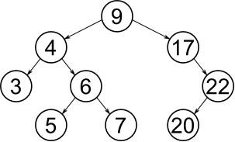
Part I: What is a Binary Tree
There are many variants of binary trees.
Binary Search Tree (BST)
A binary search tree is a binary tree where, each left child node has a value that is smaller than (according to some total order) the value of its parent node, while each right child node has a value that is larger than the value of its parent node.
Notes:
In computer science, binary search tree is a very commonly used binary tree structure. It has the bene

Slide 18
Part I: What is a Binary Tree
Binary Search Tree
allows fast lookup, addition and removal of items
a fundamental data structure used to construct more abstract data structures such as sets, multisets, and associative arrays.
Algorithm Average Worst Case
Space Θ(n) O(n)
Search Θ(log n) O(n)
Insert Θ(log n) O(n)
Delete Θ(log n) O(n)
Traverse on BST
Pre-order walk (root, left, right) : 9->4->3->6->5->7->17->22->20
Post-order walk (left, right, root): 3->5->7->6->4->20->22->17->9
In-order walk (left, root, right) The in-order walk of a binary search trees gives its nodes in sorted (increasing) order.
3->4->5->6->7->9->17->20->22
Notes:
In computer science, binary search tree is a very commonly used binary tree structure.
Besides the basic CRUD operations, BST is also good for sorting data. There are 3 way of traverse data stored in BST.
Traversing a tree is a way of visiting each of its nodes exactly once.

Slide 19
Part I: What is a Binary Tree
In Summary:
A Binary Tree is a tree that every node in it has at most 2 child nodes
There are many variant of Binary Trees, such as
Perfect Binary Tree
Complete Binary Tree
Balanced Binary Tree
Etc.
A Binary Search Tree is such a binary tree that
every left node has a smaller value than its parent node,
while every right node has a bigger value than its parent node
It is a fundamental data structure for
fast node operations
and data sorting.
Notes:
In computer science, binary search tree is a very commonly used binary tree structure.
Besides the basic CRUD operations, BST is also good for sorting data. There are 3 way of traverse data stored in BST.
Traversing a tree is a way of visiting each of its nodes exactly once.

Slide 20
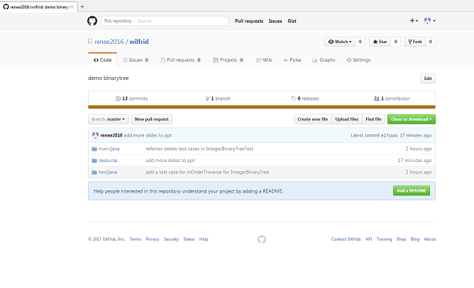
Part II: A Binary Tree Implementation
Java Project
IntelliJ IDEA 2016.3 Community Edition
Maven Project
TDD approach
GitHub
https://github.com/renee2016/wilfrid
Notes:
In computer science, binary search tree is a very commonly used binary tree structure.
Besides the basic CRUD operations, BST is also good for sorting data. There are 3 way of traverse data stored in BST.
Traversing a tree is a way of visiting each of its nodes exactly once.

Slide 21
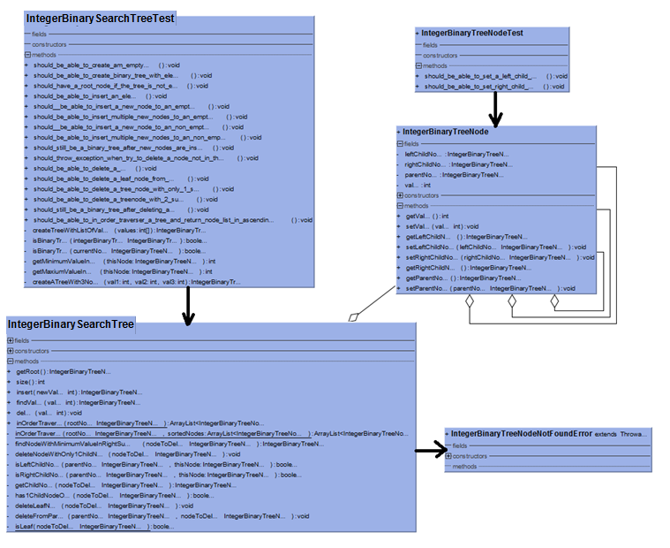
Part II: A Binary Tree Implementation
Notes:
In computer science, binary search tree is a very commonly used binary tree structure.
Besides the basic CRUD operations, BST is also good for sorting data. There are 3 way of traverse data stored in BST.
Traversing a tree is a way of visiting each of its nodes exactly once.

Slide 22
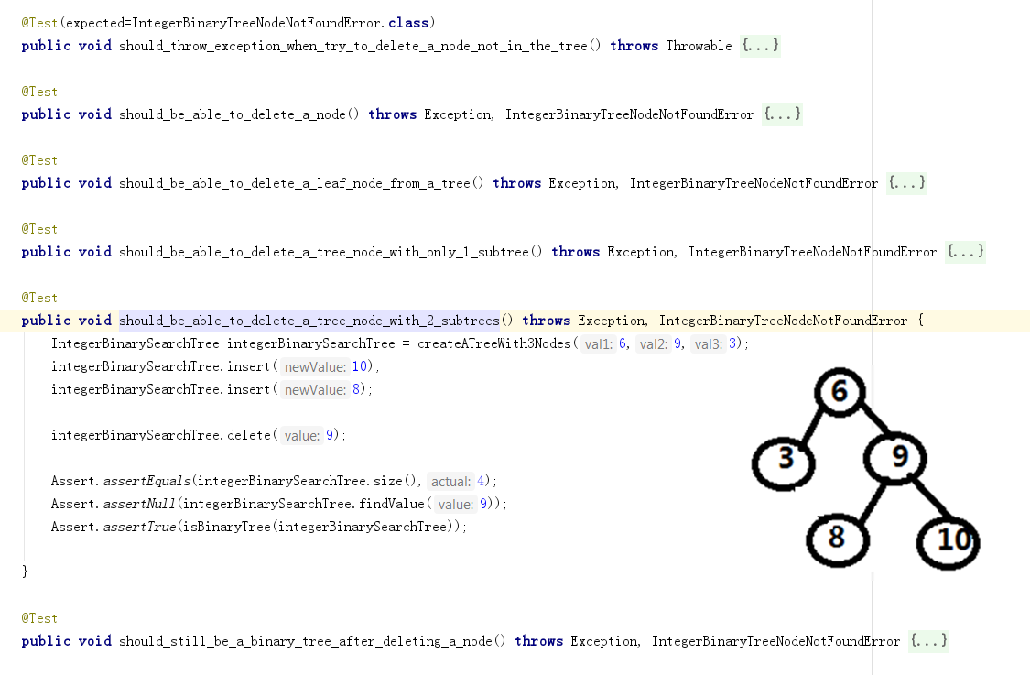
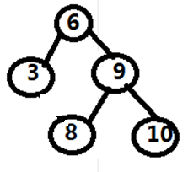
Part II: A Binary Tree Implementation
Notes:
In computer science, binary search tree is a very commonly used binary tree structure.
Besides the basic CRUD operations, BST is also good for sorting data. There are 3 way of traverse data stored in BST.
Traversing a tree is a way of visiting each of its nodes exactly once.

Slide 23
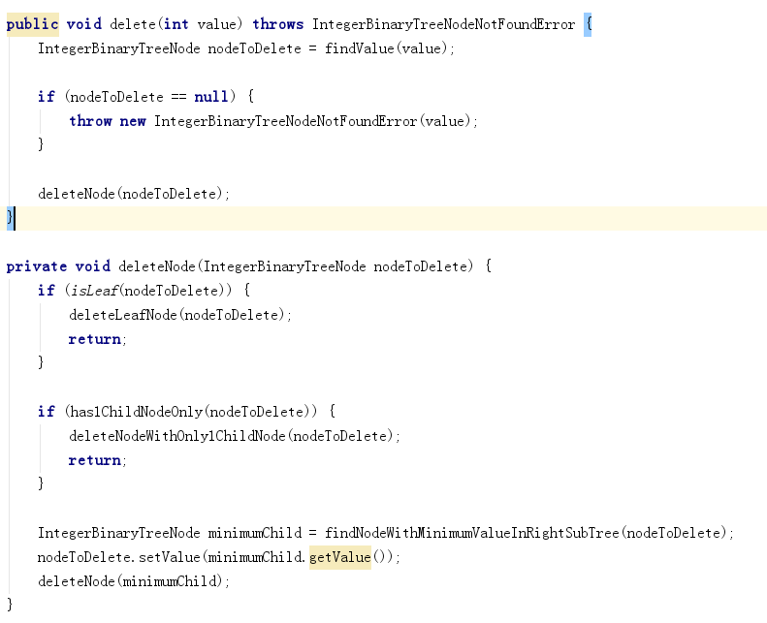
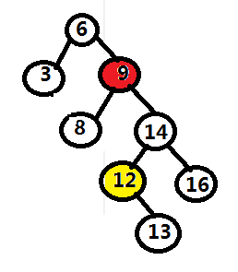
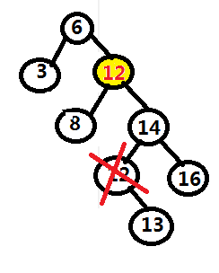
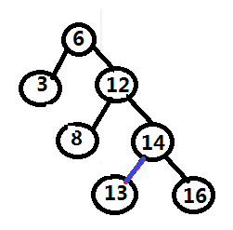
Part II: A Binary Tree Implementation
Notes:
In computer science, binary search tree is a very commonly used binary tree structure.
Besides the basic CRUD operations, BST is also good for sorting data. There are 3 way of traverse data stored in BST.
Traversing a tree is a way of visiting each of its nodes exactly once.

Slide 24
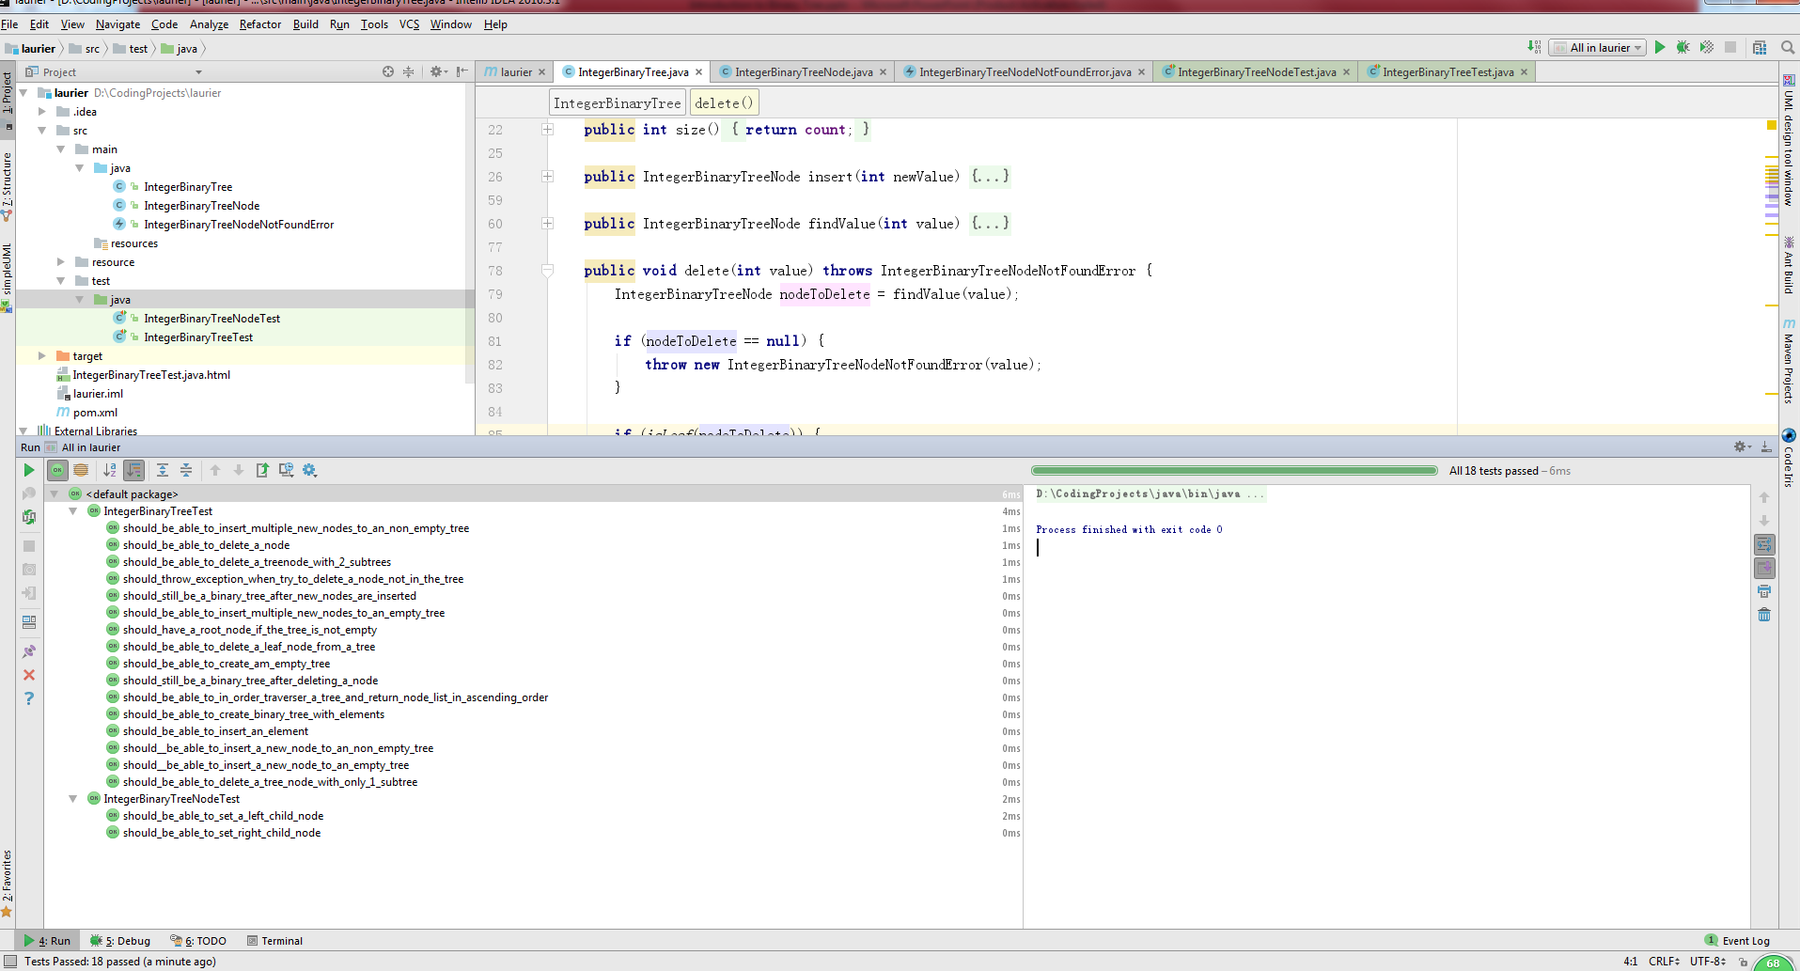
Part II: A Binary Tree Implementation
Notes:
In computer science, binary search tree is a very commonly used binary tree structure.
Besides the basic CRUD operations, BST is also good for sorting data. There are 3 way of traverse data stored in BST.
Traversing a tree is a way of visiting each of its nodes exactly once.

Slide 25


Notes:
In computer science, binary search tree is a very commonly used binary tree structure.
Besides the basic CRUD operations, BST is also good for sorting data. There are 3 way of traverse data stored in BST.
Traversing a tree is a way of visiting each of its nodes exactly once.

